Slide 1
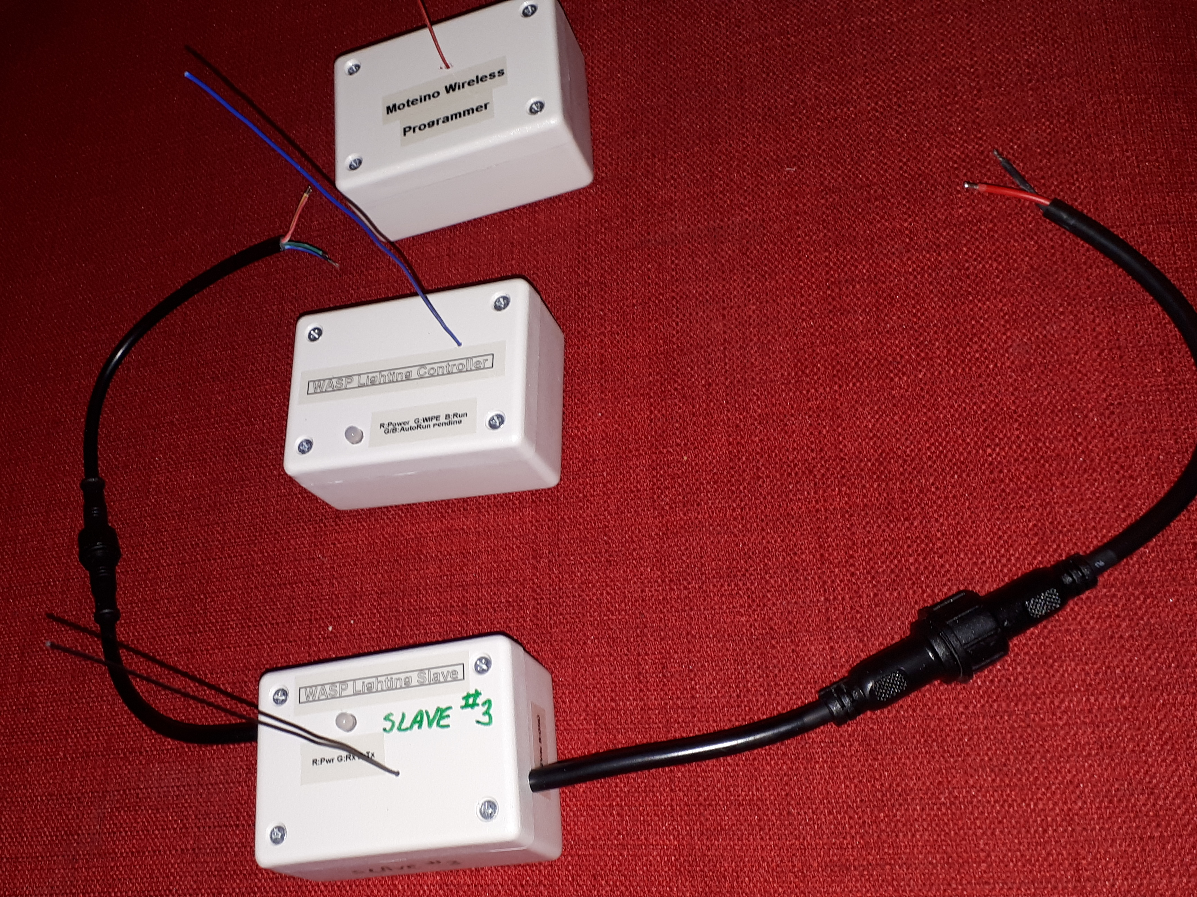
WASP
Construction
Summary
John van Schouwen
2019-04-08

Slide 2
Outline
WASP Lighting Controller
WASP Lighting Slave
Moteino Wireless Programmer
RGB LED Pixel String Variations

Slide 3
WASP Controller

Slide 4
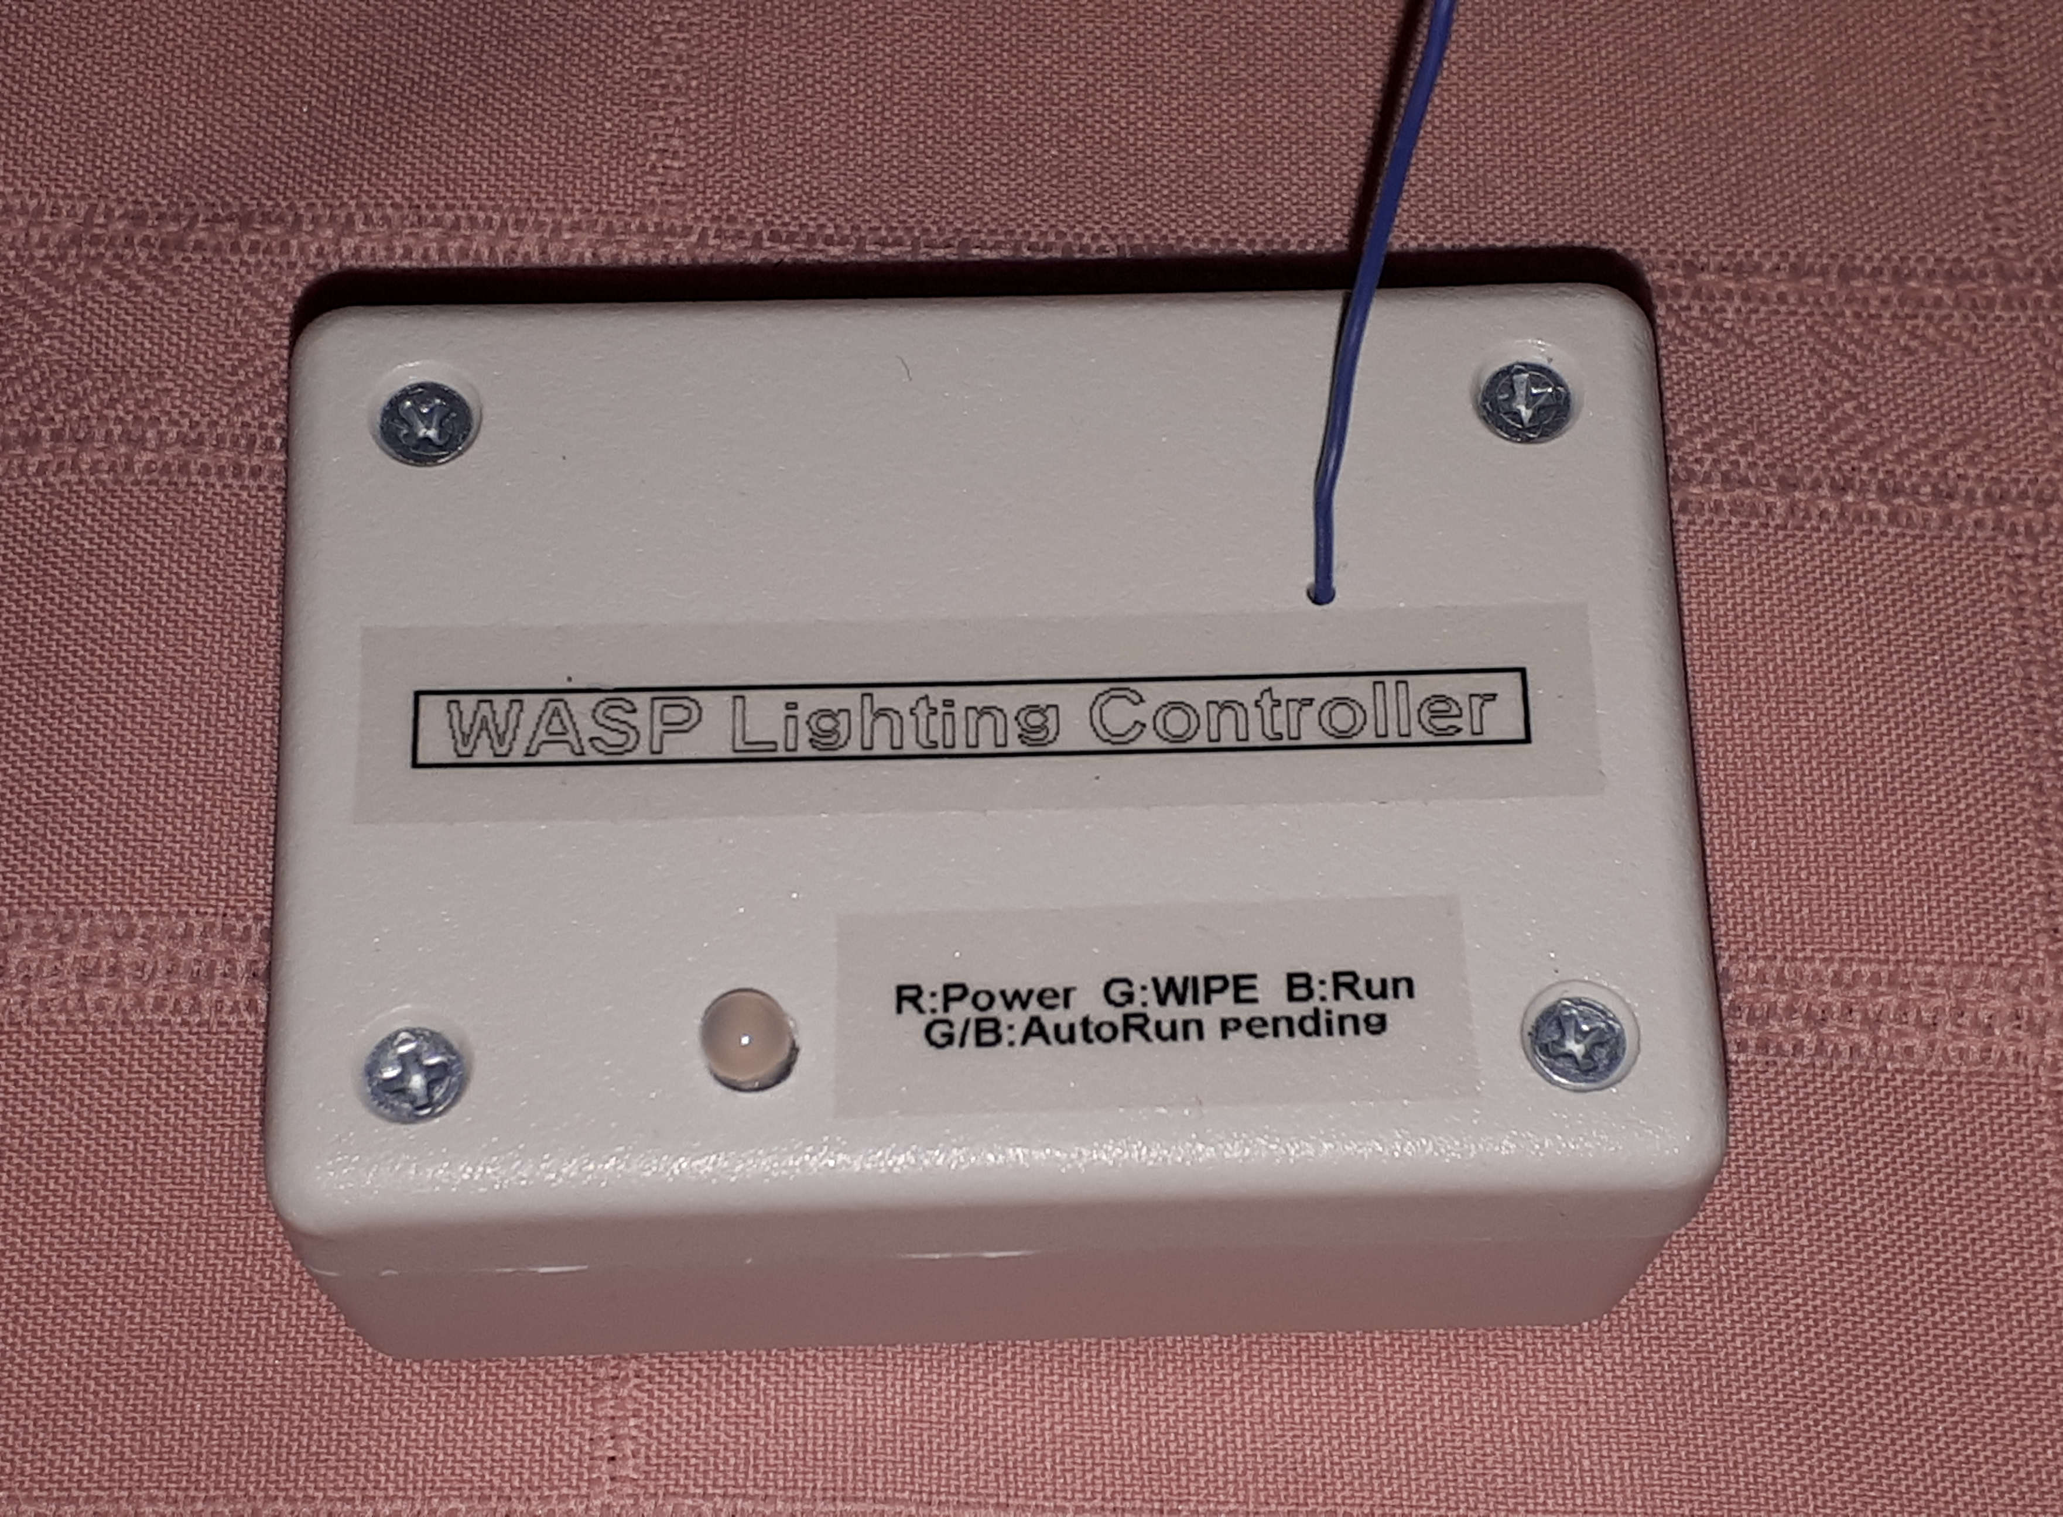

Slide 5
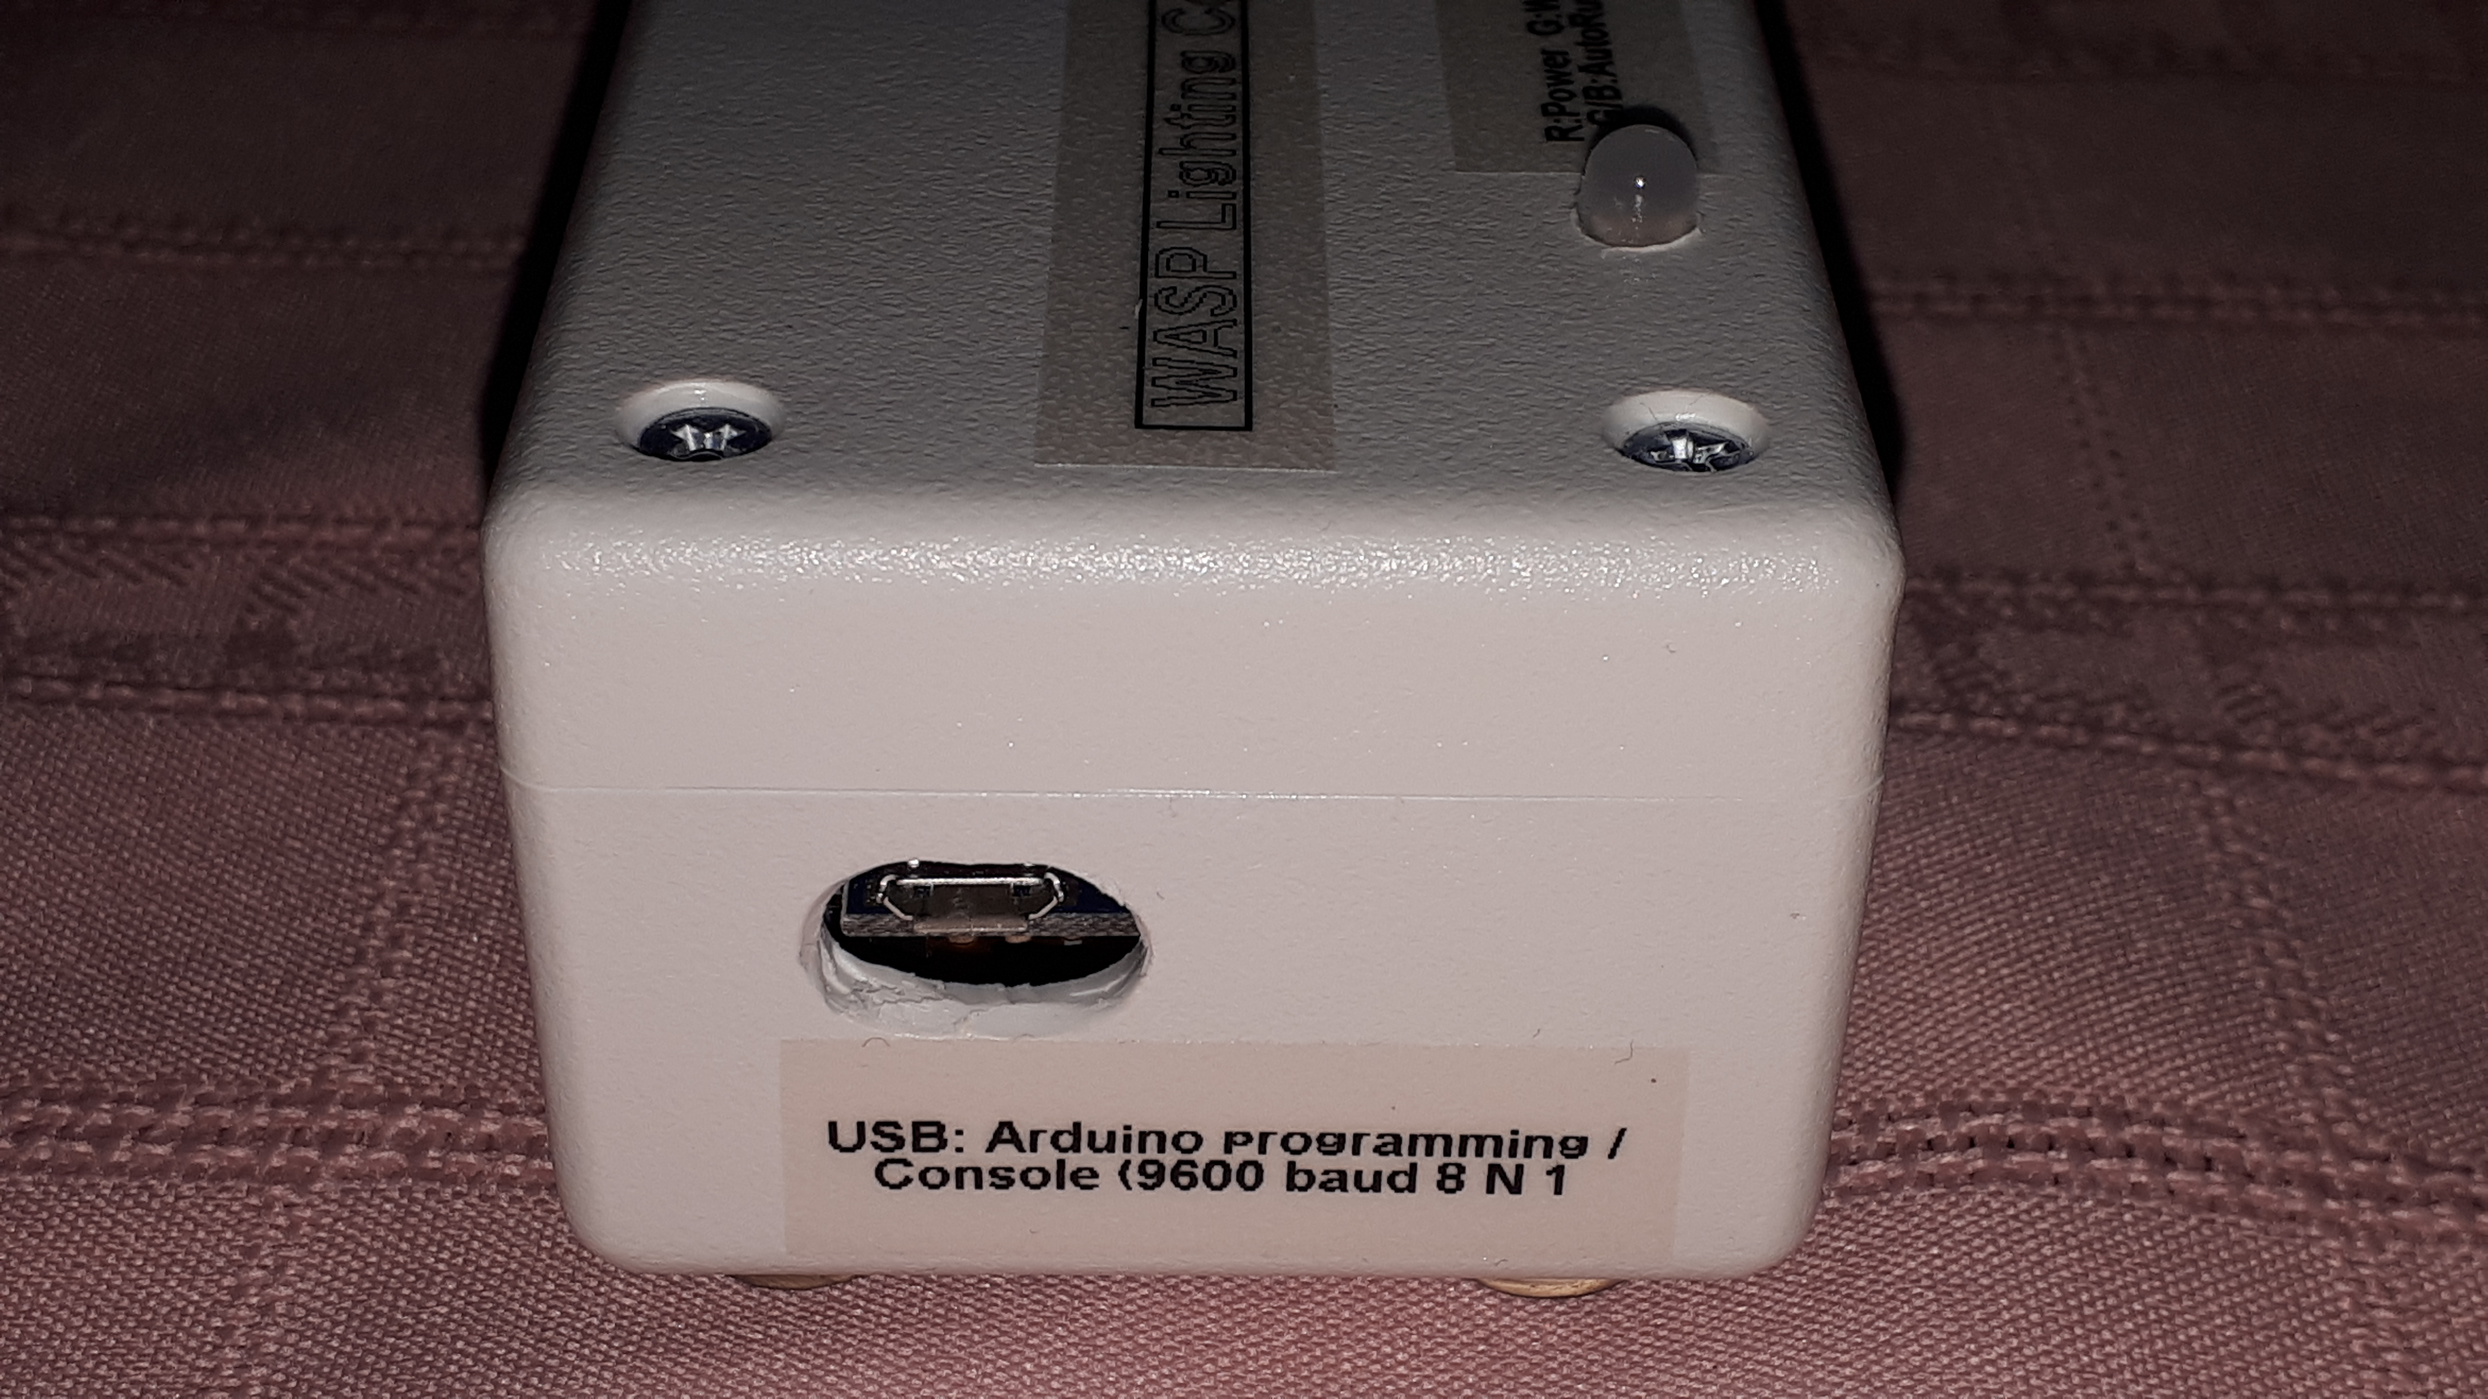

Slide 6
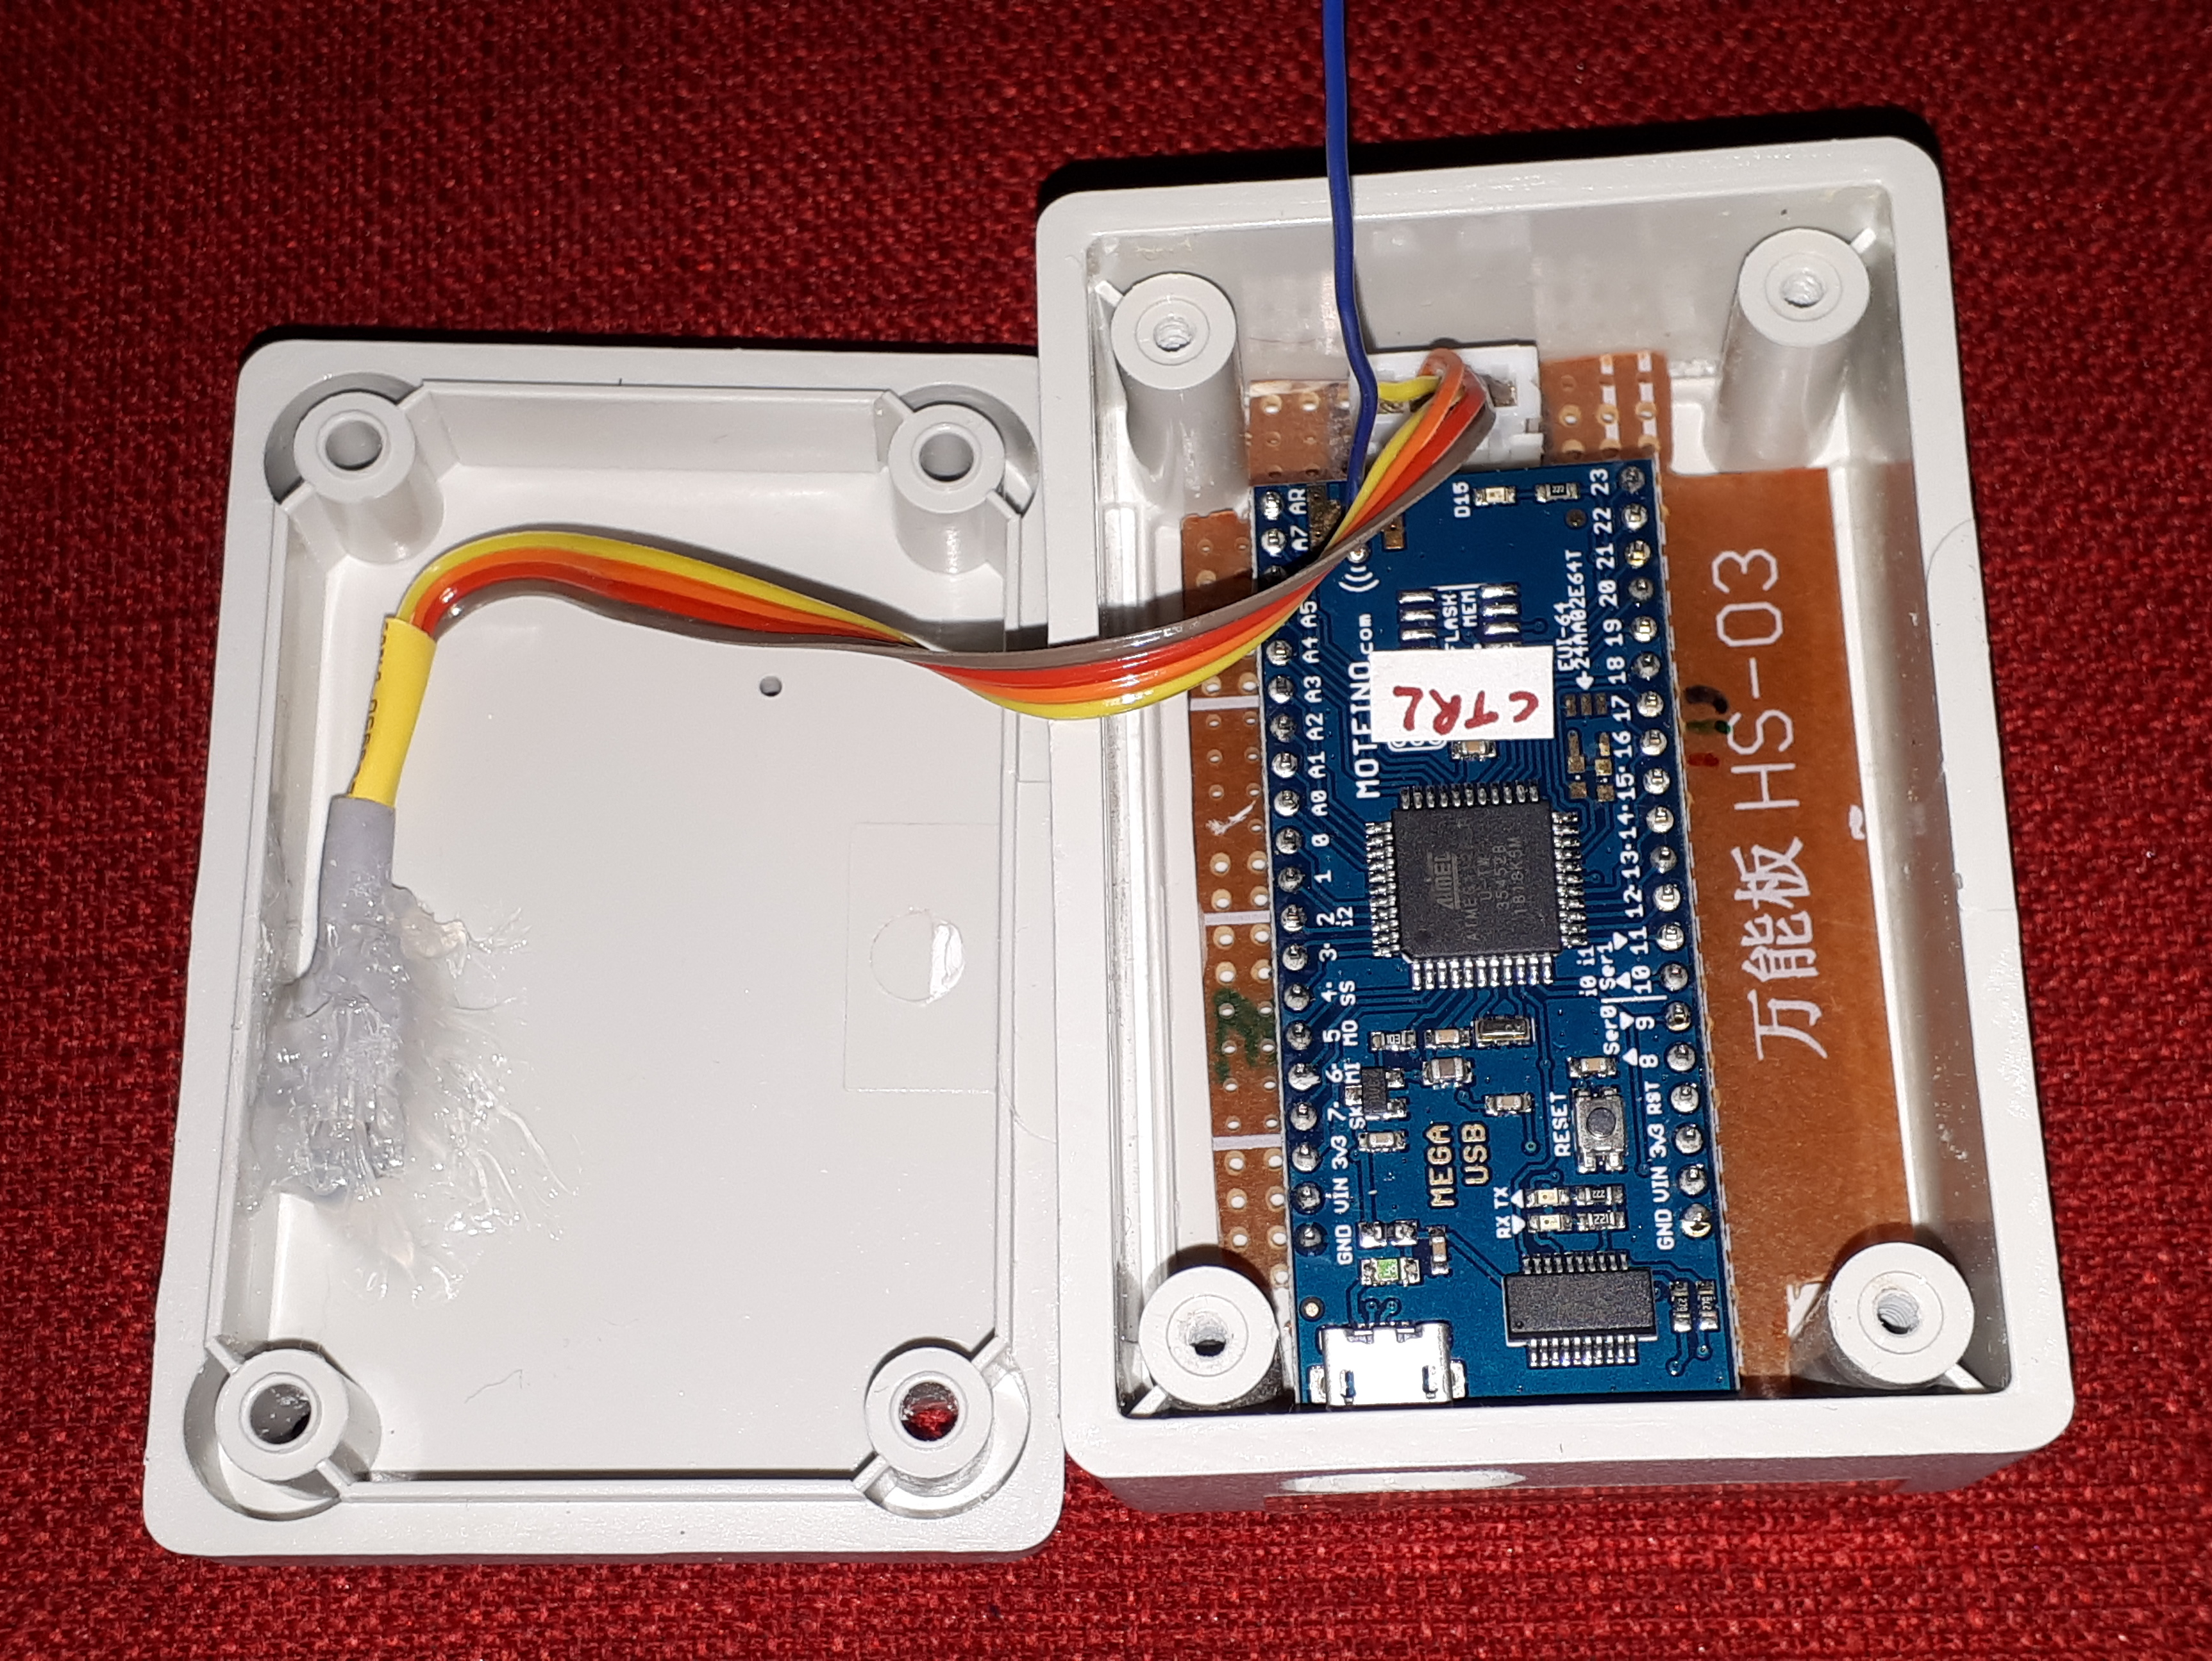

Slide 7
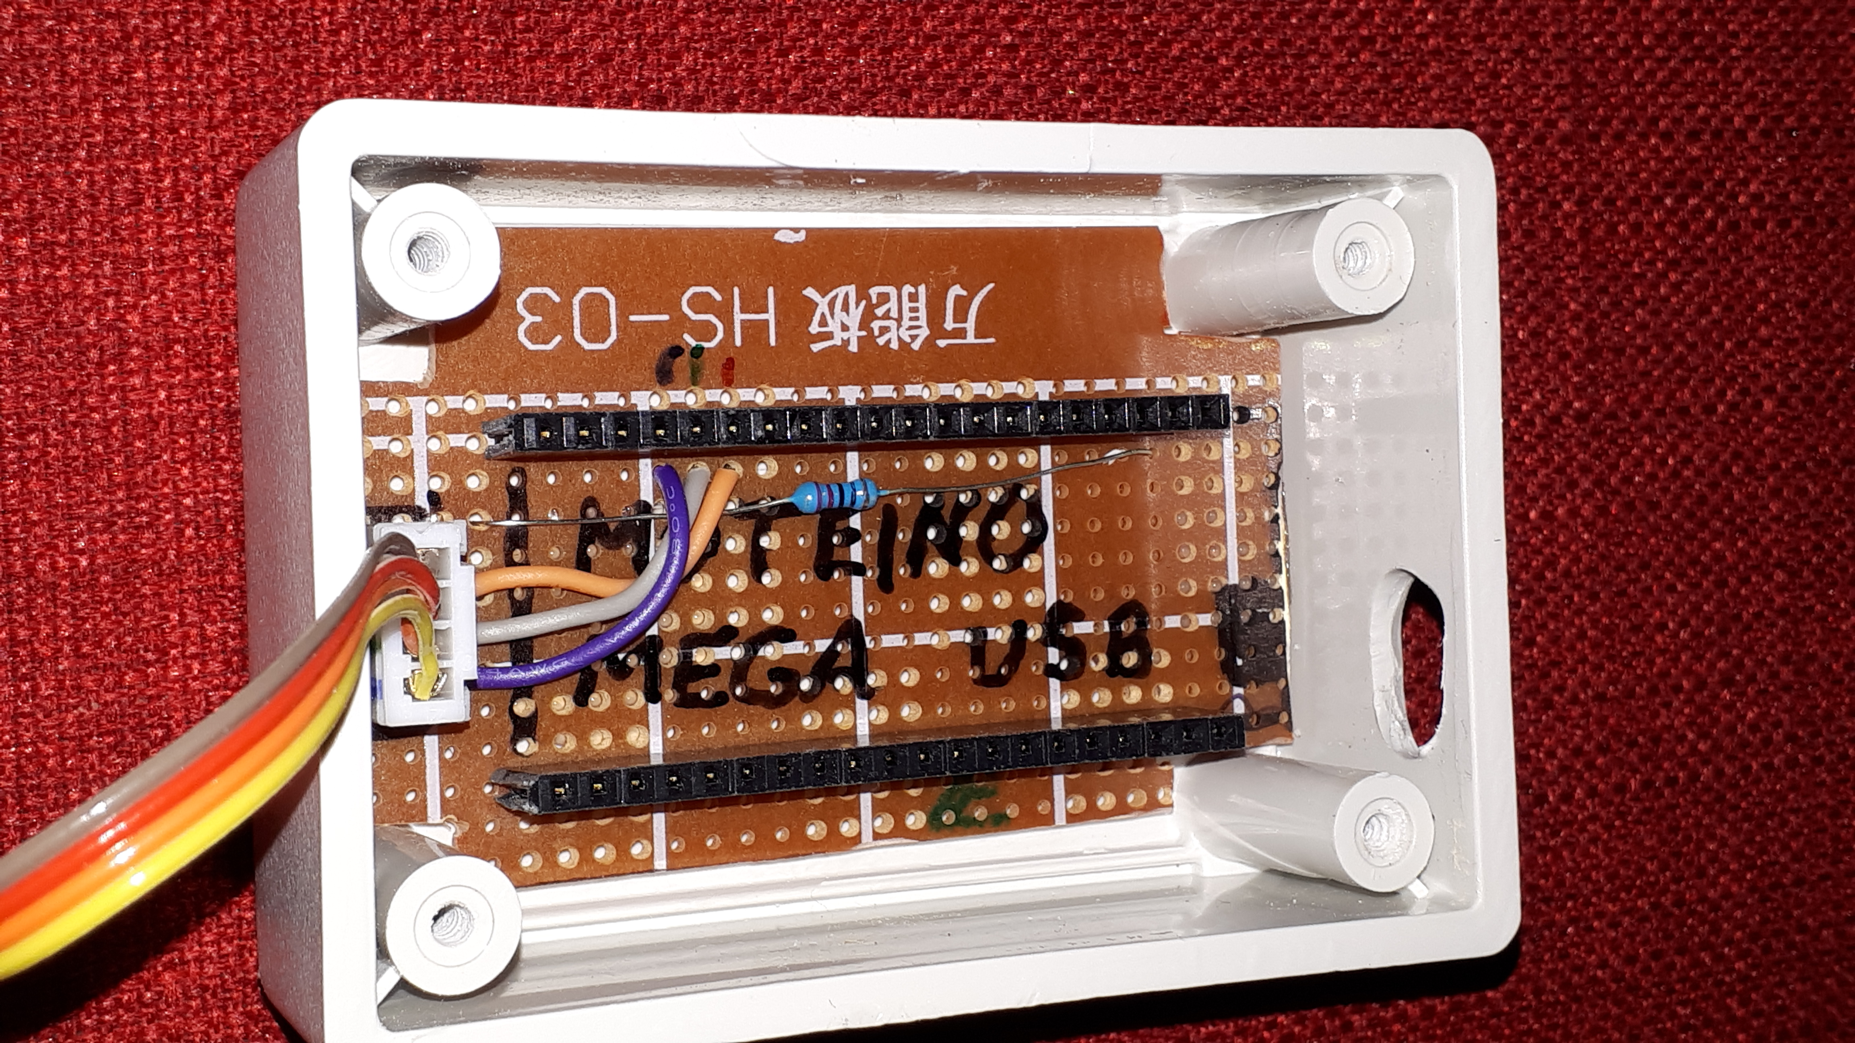

Slide 8
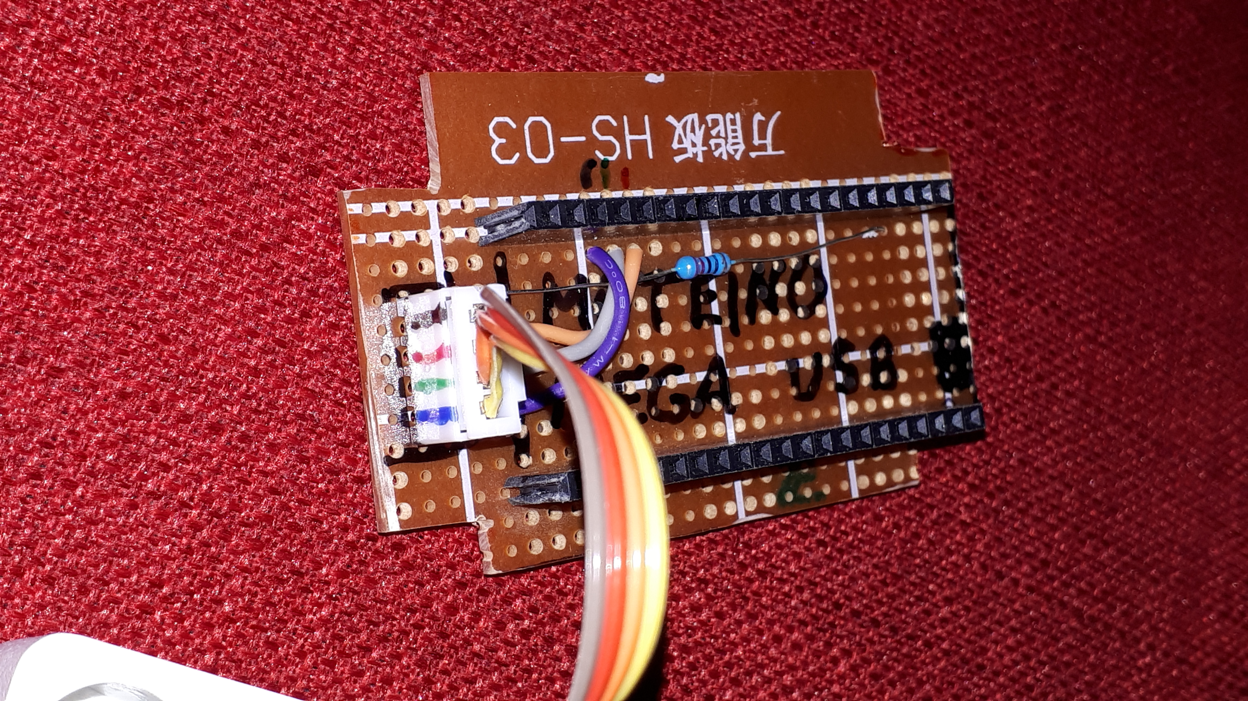
Common cathode RGB LED connector. From top to bottom:
Ground
Red LED +ve
Green LED +ve
Blue LED +ve
Moteino GND pin

Slide 9
WASP Slave

Slide 10
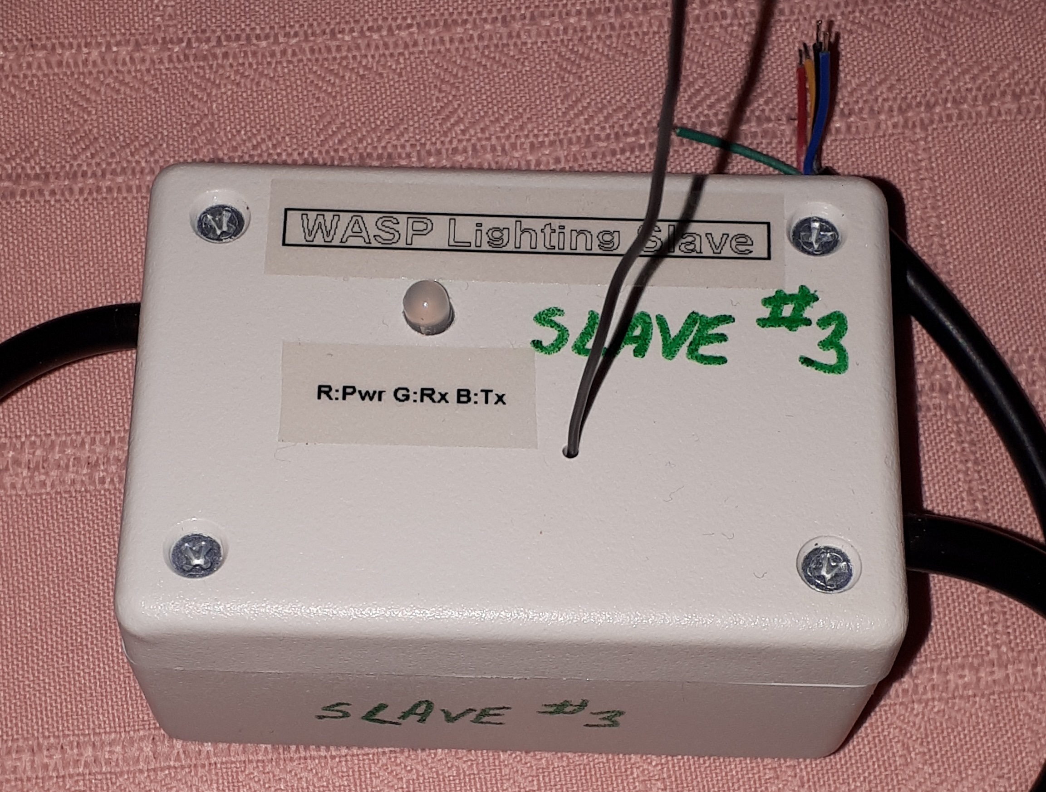

Slide 11
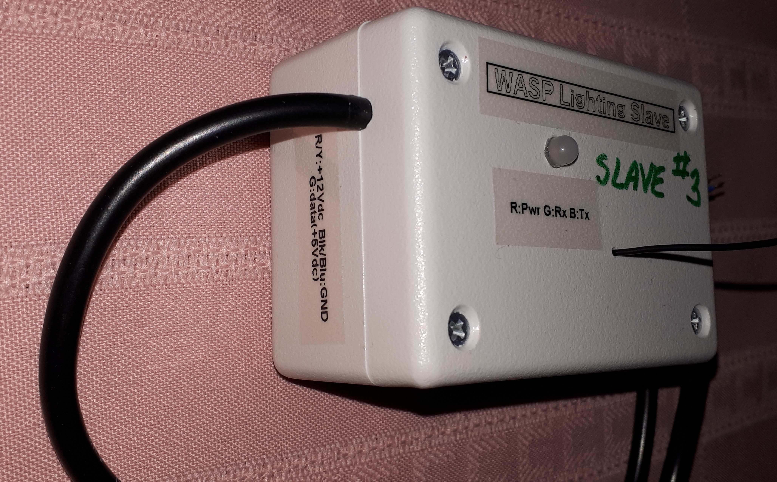

Slide 12
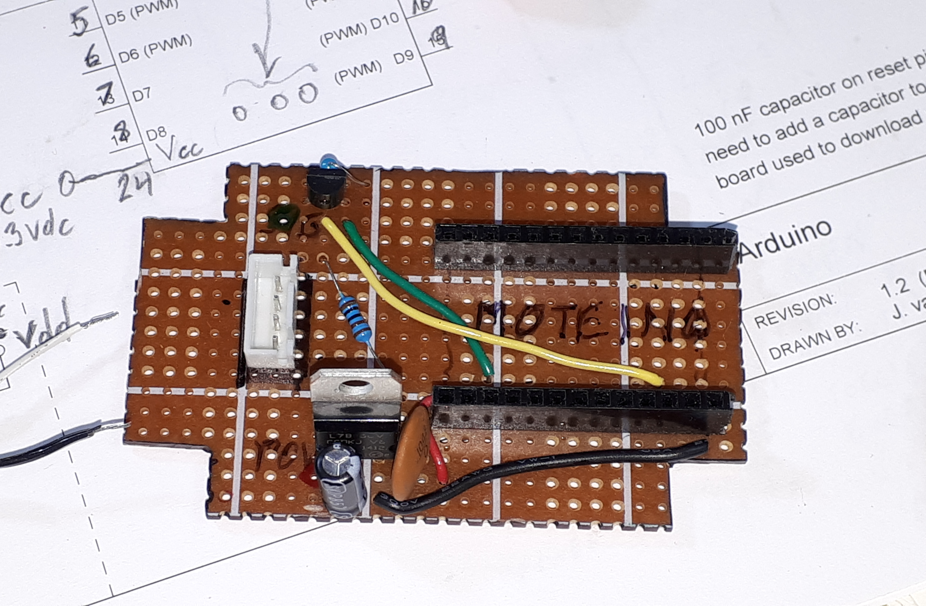

Slide 13
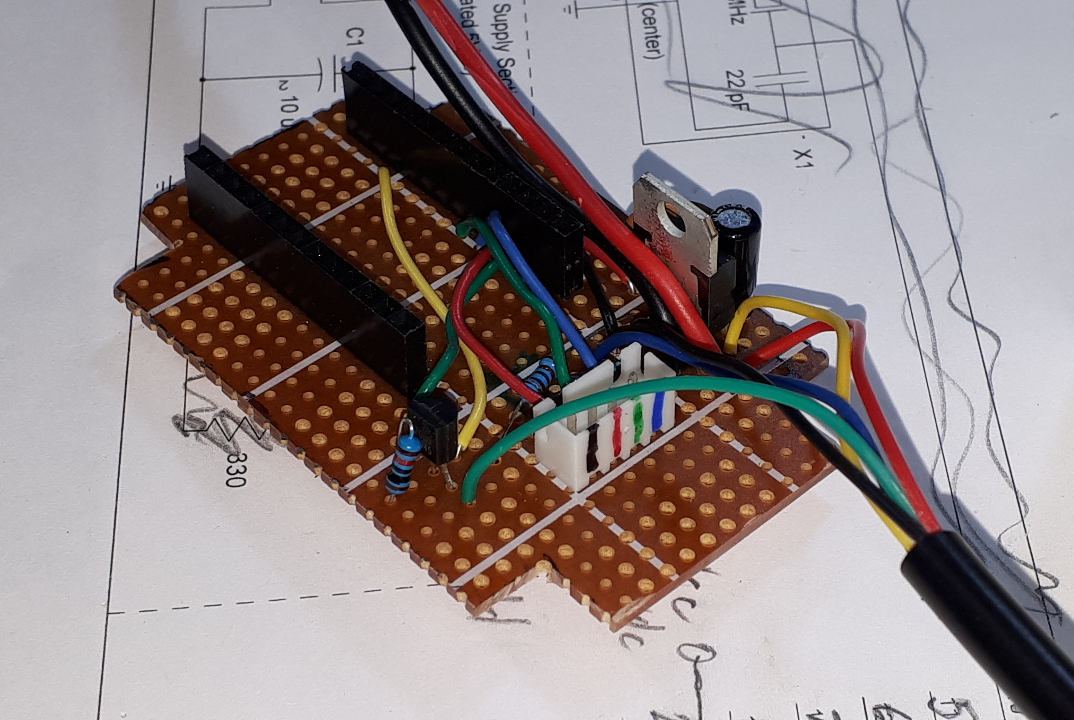
Moteino GND pin
Common cathode RGB LED connector. From left to right:
Ground
Red LED +ve
Green LED +ve
Blue LED +ve

Slide 14
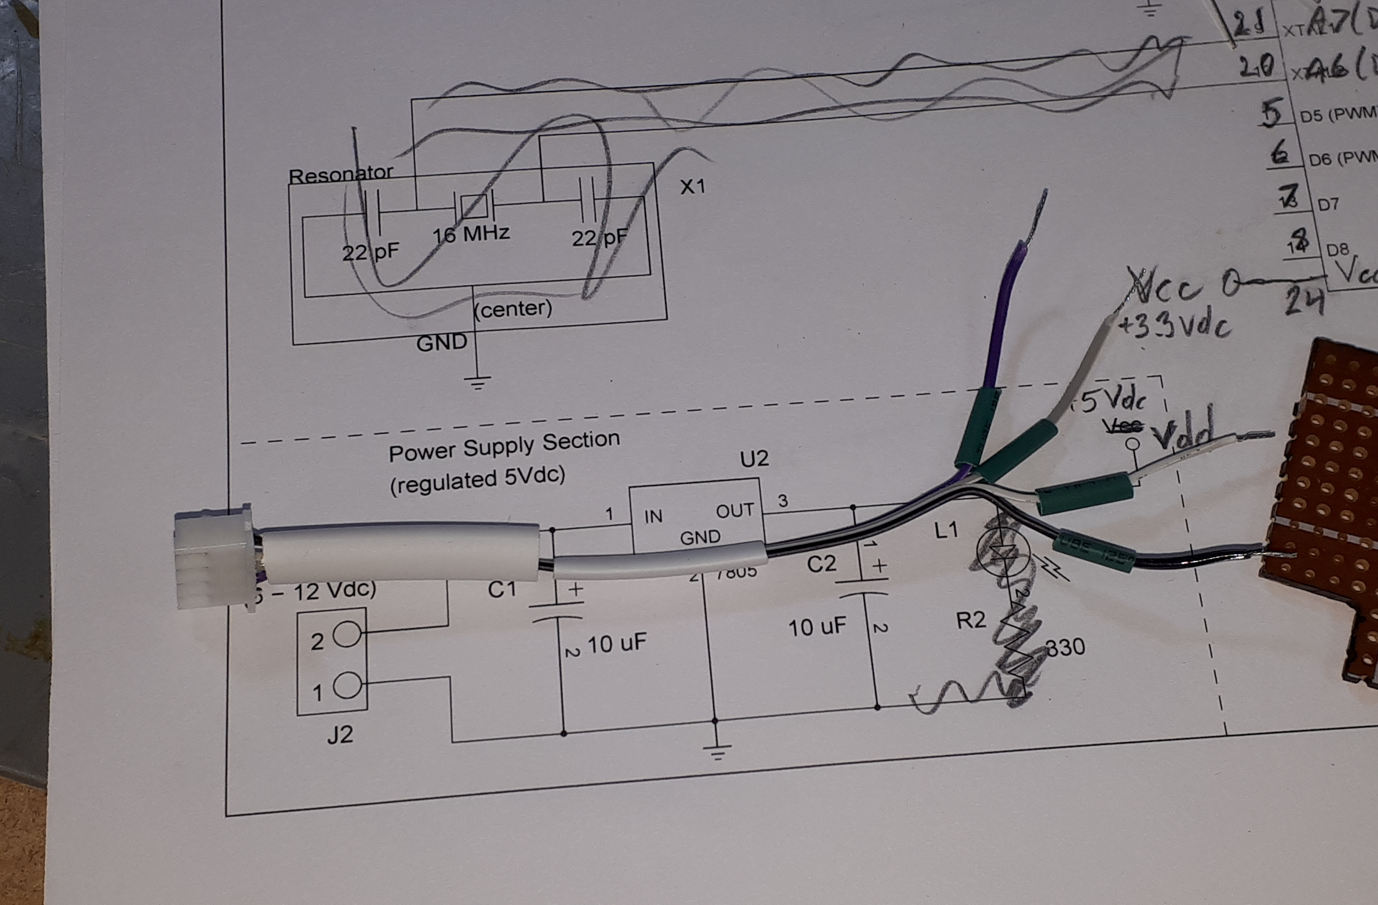

Slide 15
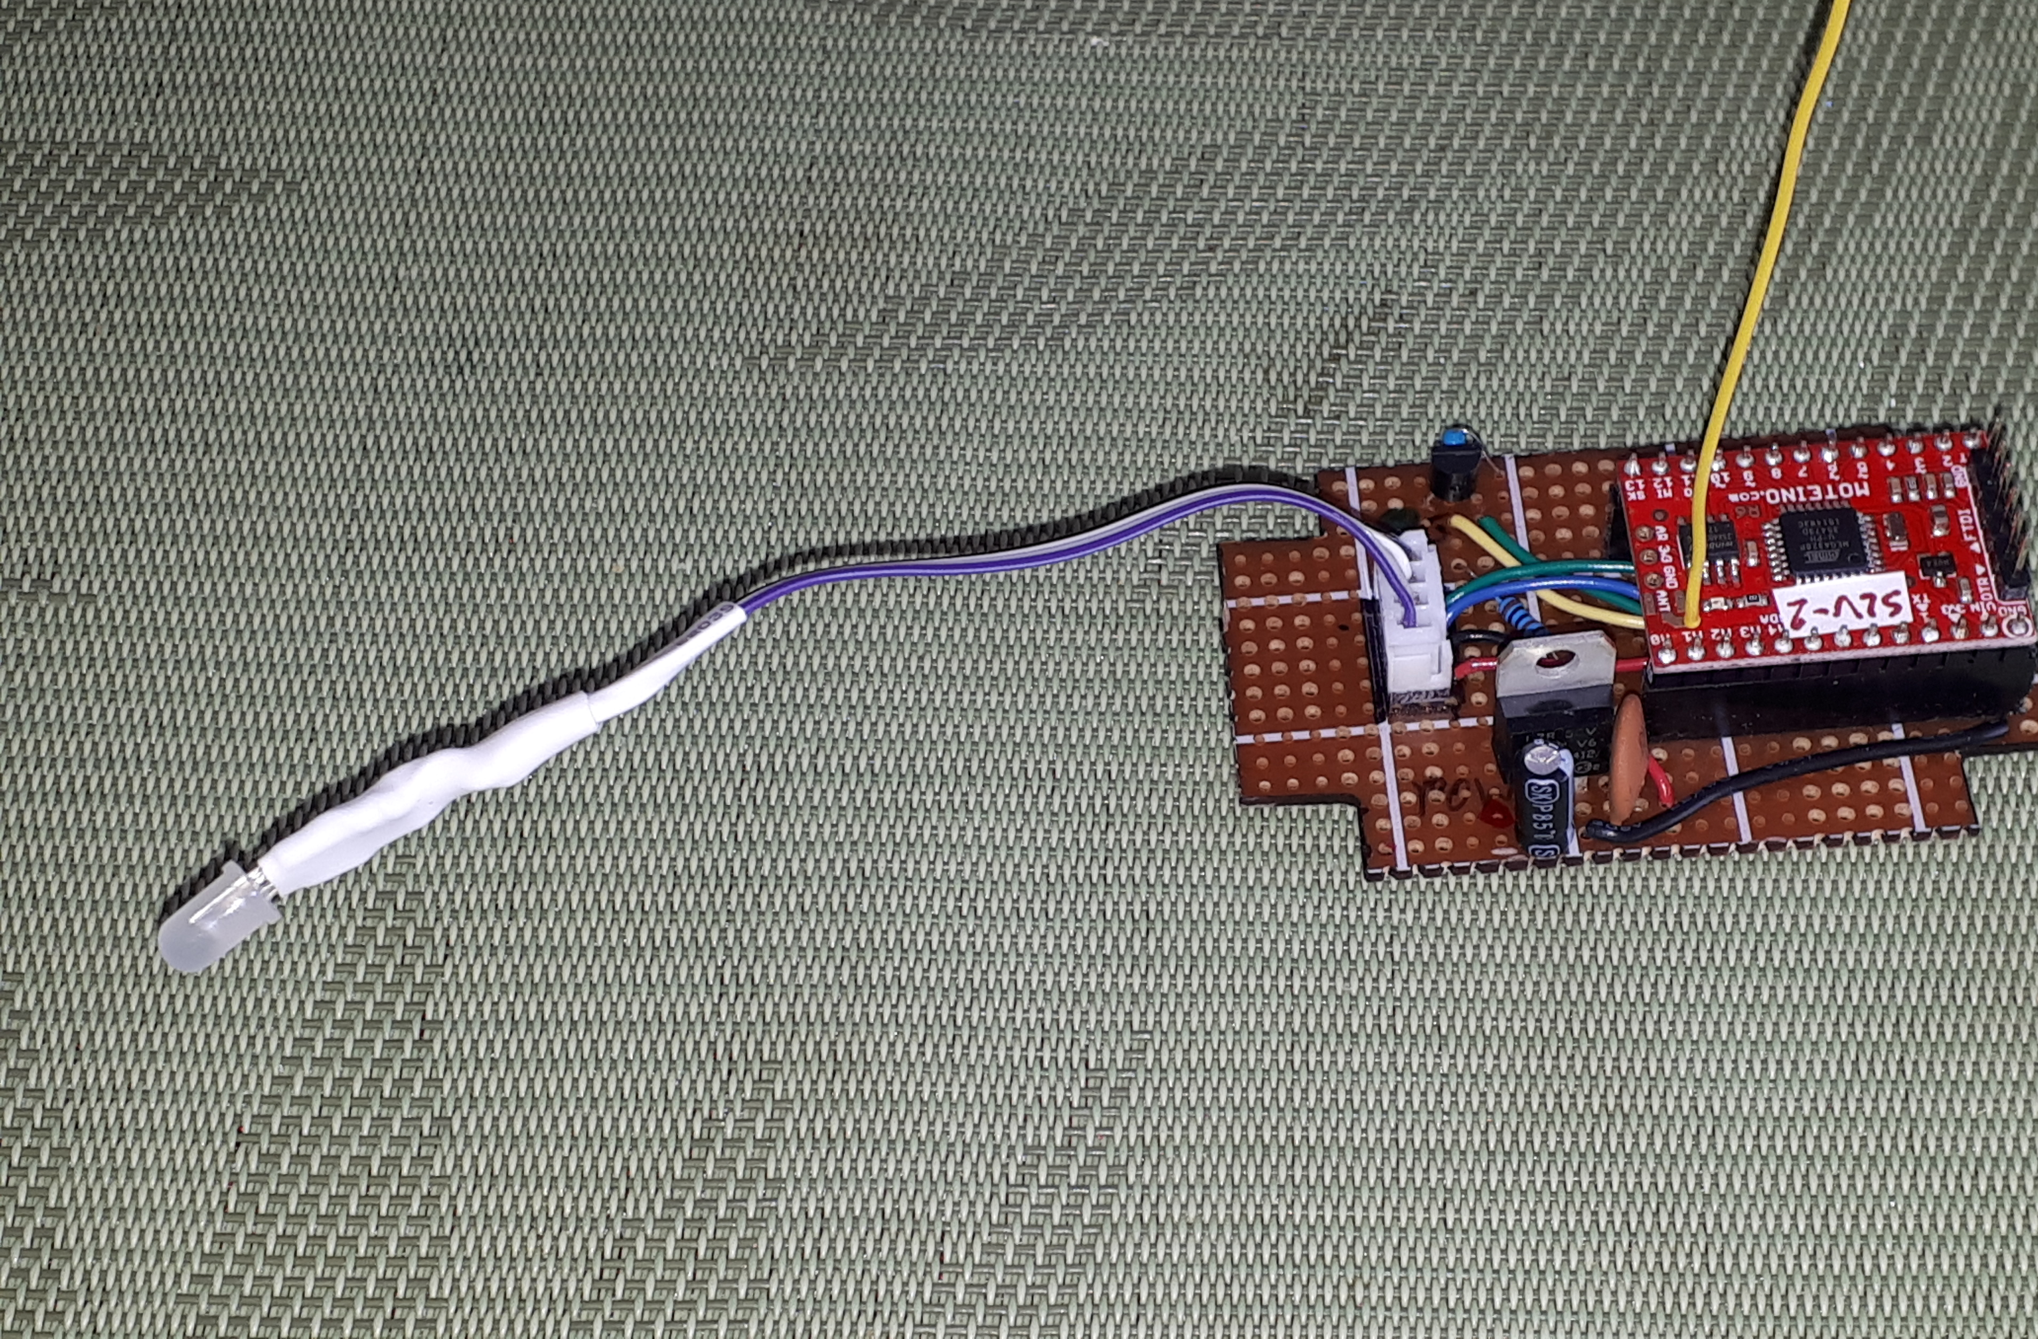

Slide 16
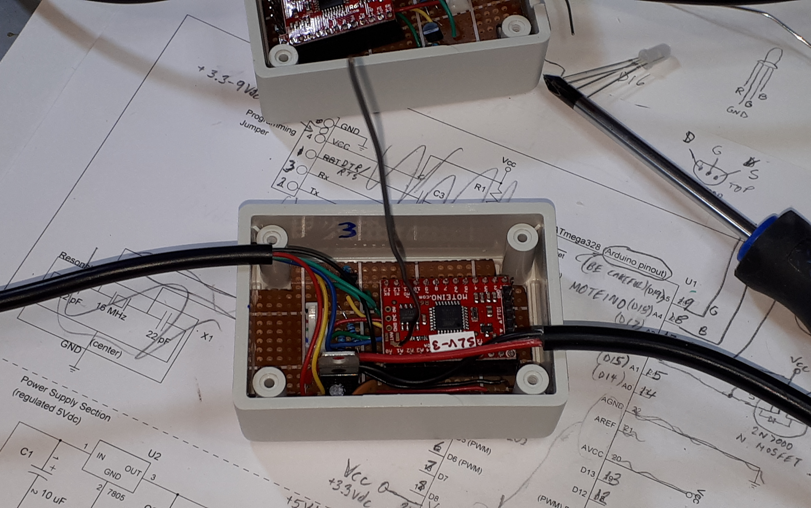

Slide 17
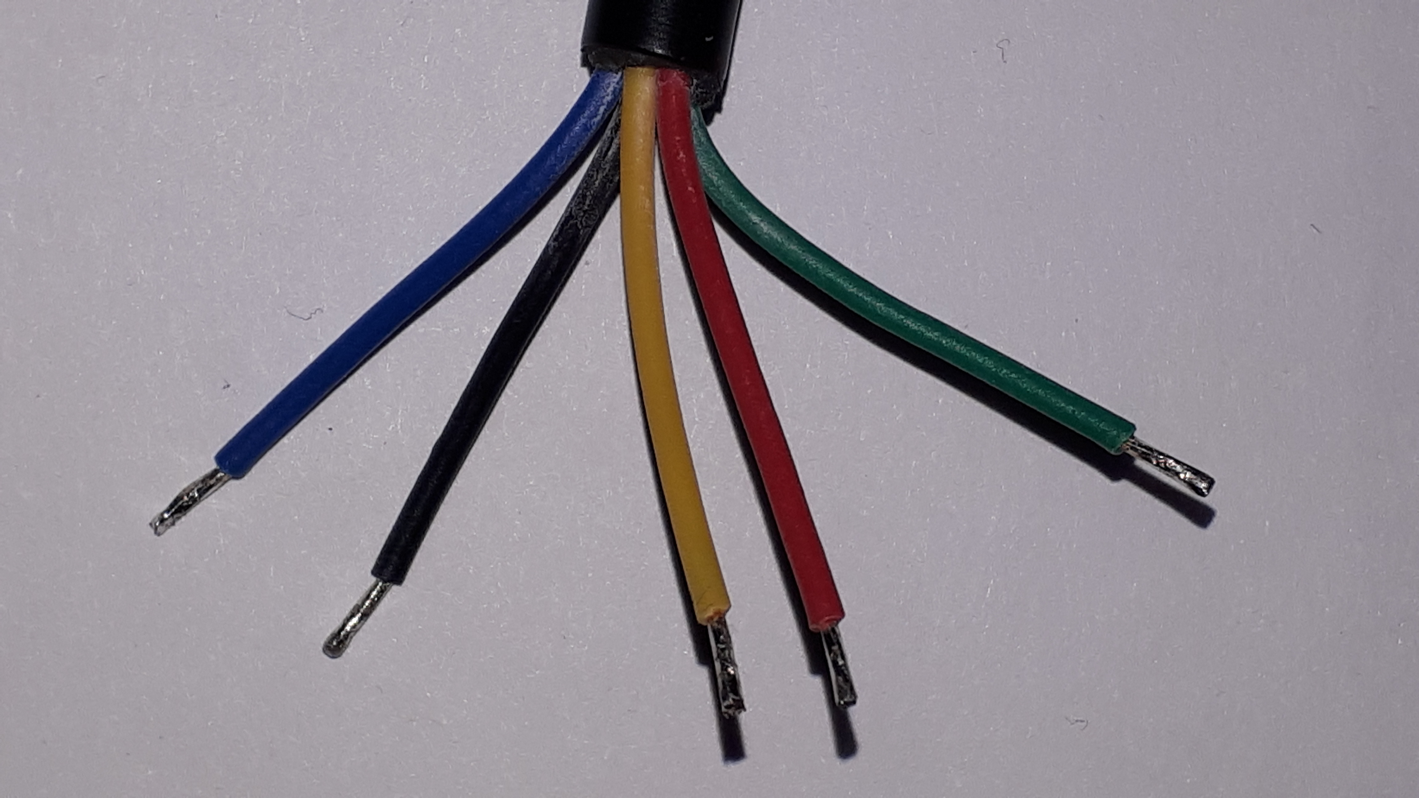
WASP Slave’s Control Cable
Ground
+12 Vdc
To pixel string’s data pin (DIN)

Slide 18
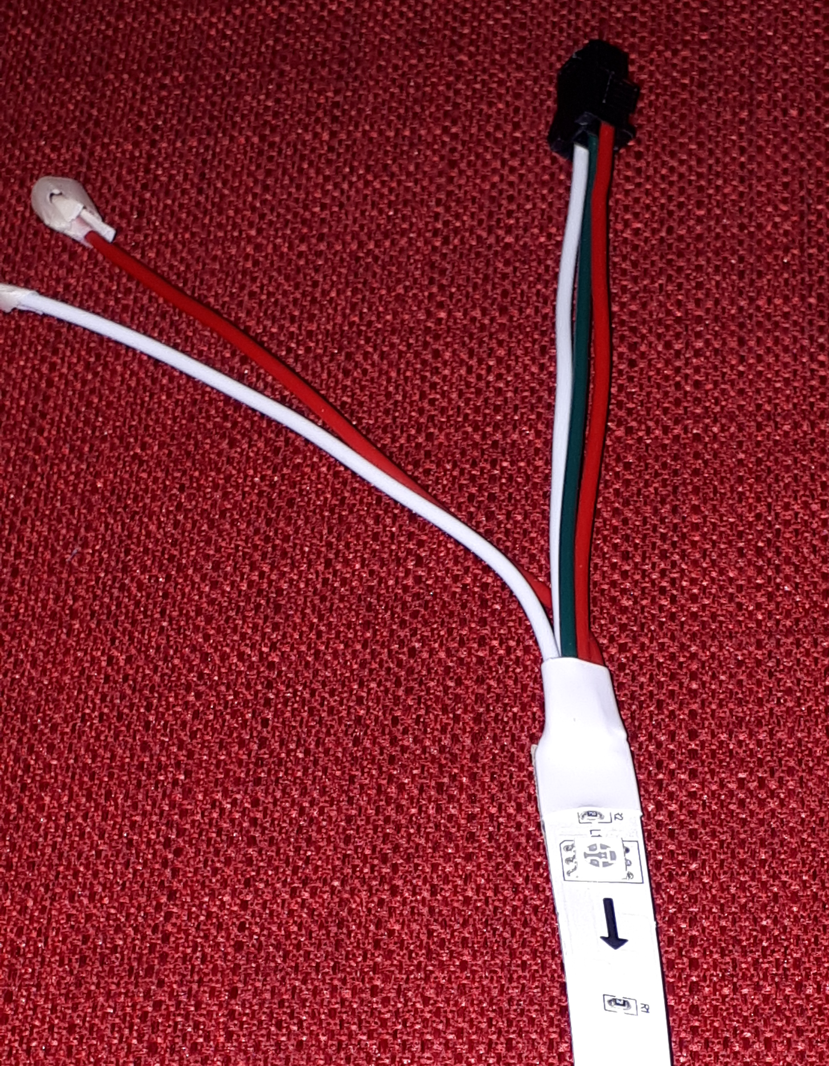
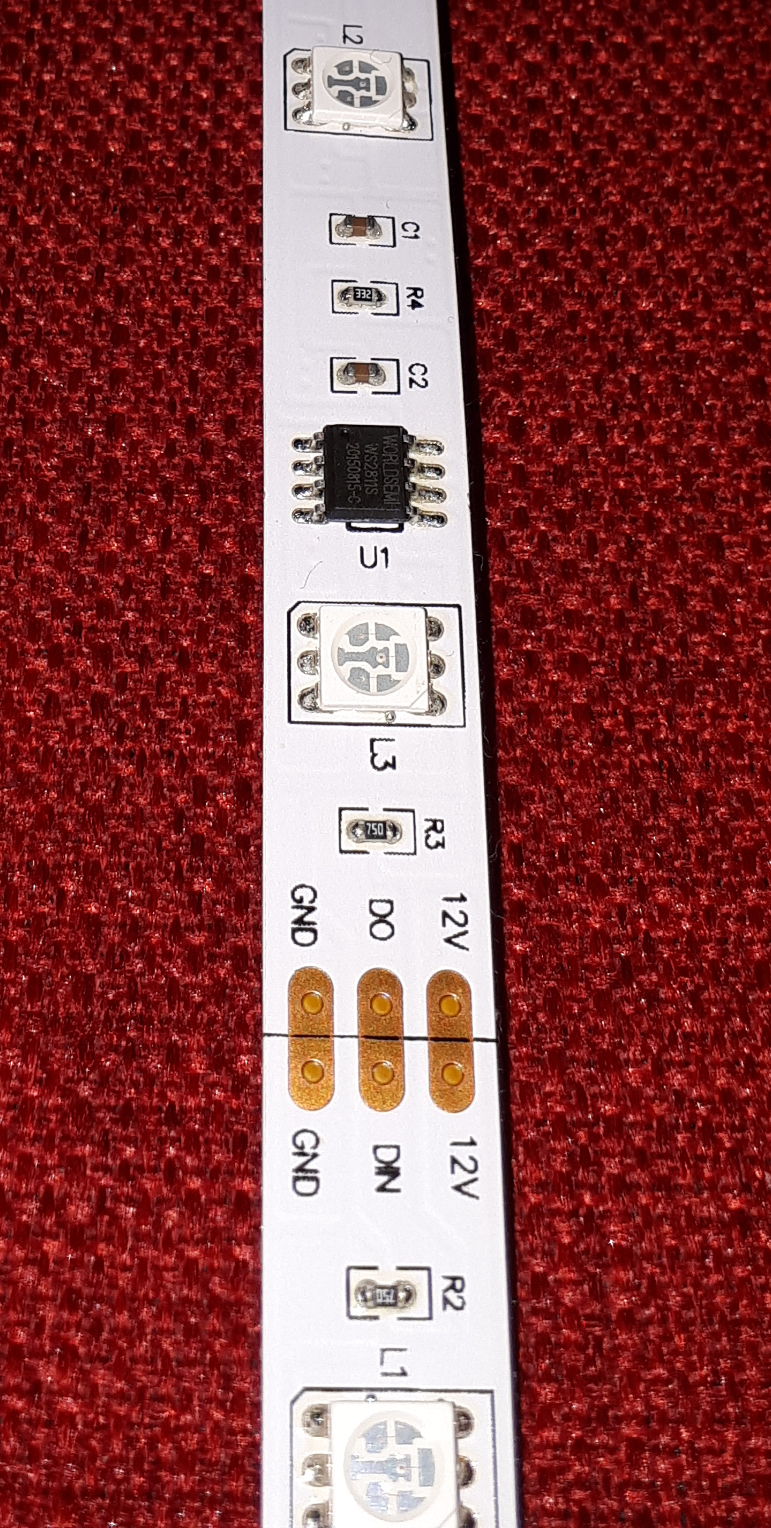
Pixel String Connections
White: Ground
Green: Data In (DIN)
Alternate
+12 Vdc
wire
Red: +12 Vdc
Alternate Ground
wire
Note the arrow indicating the DIN-to-DOUT direction. WASP slave connects on the DIN side of the pixel string.
Cut only here when necessary

Slide 19
Moteino Wireless Programmer

Slide 20
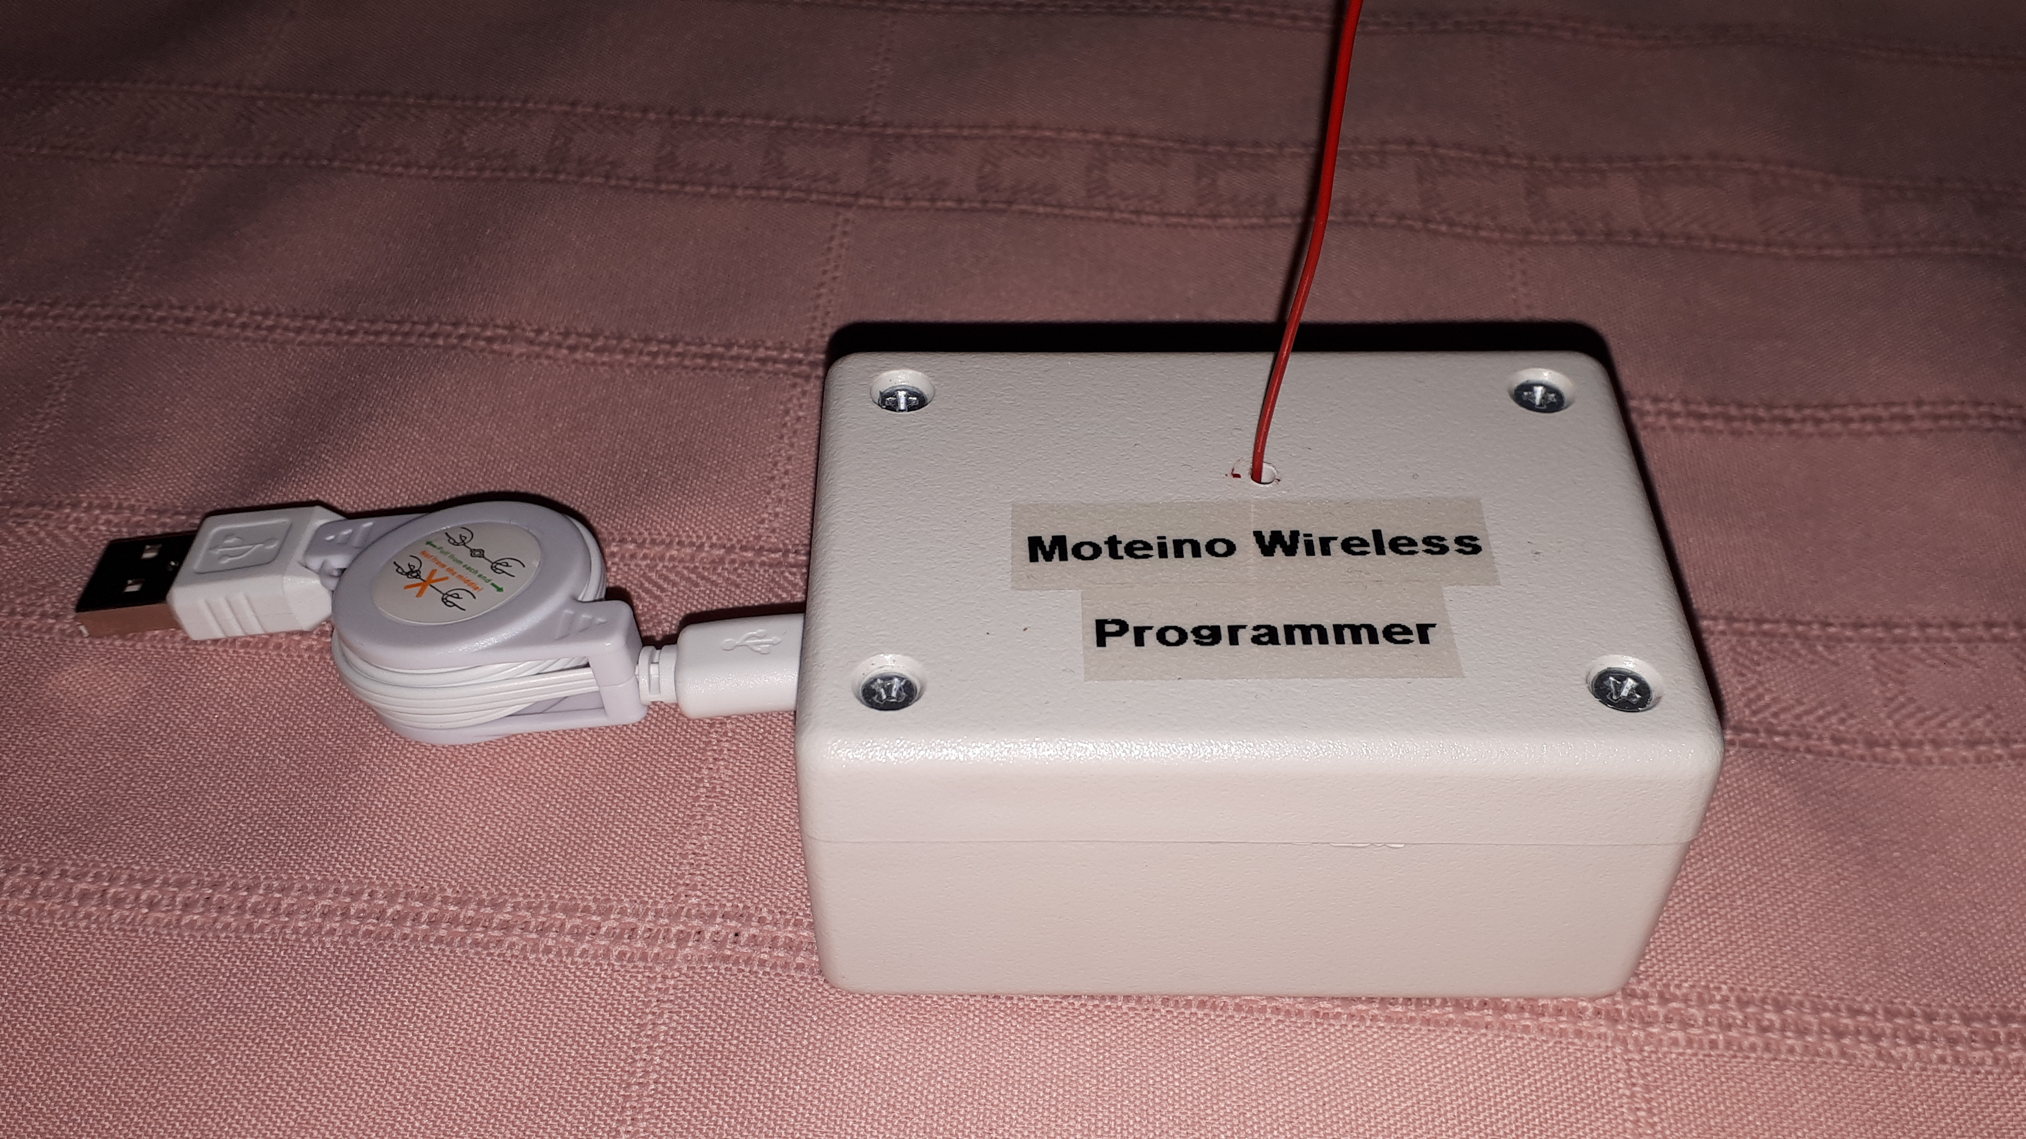

Slide 21
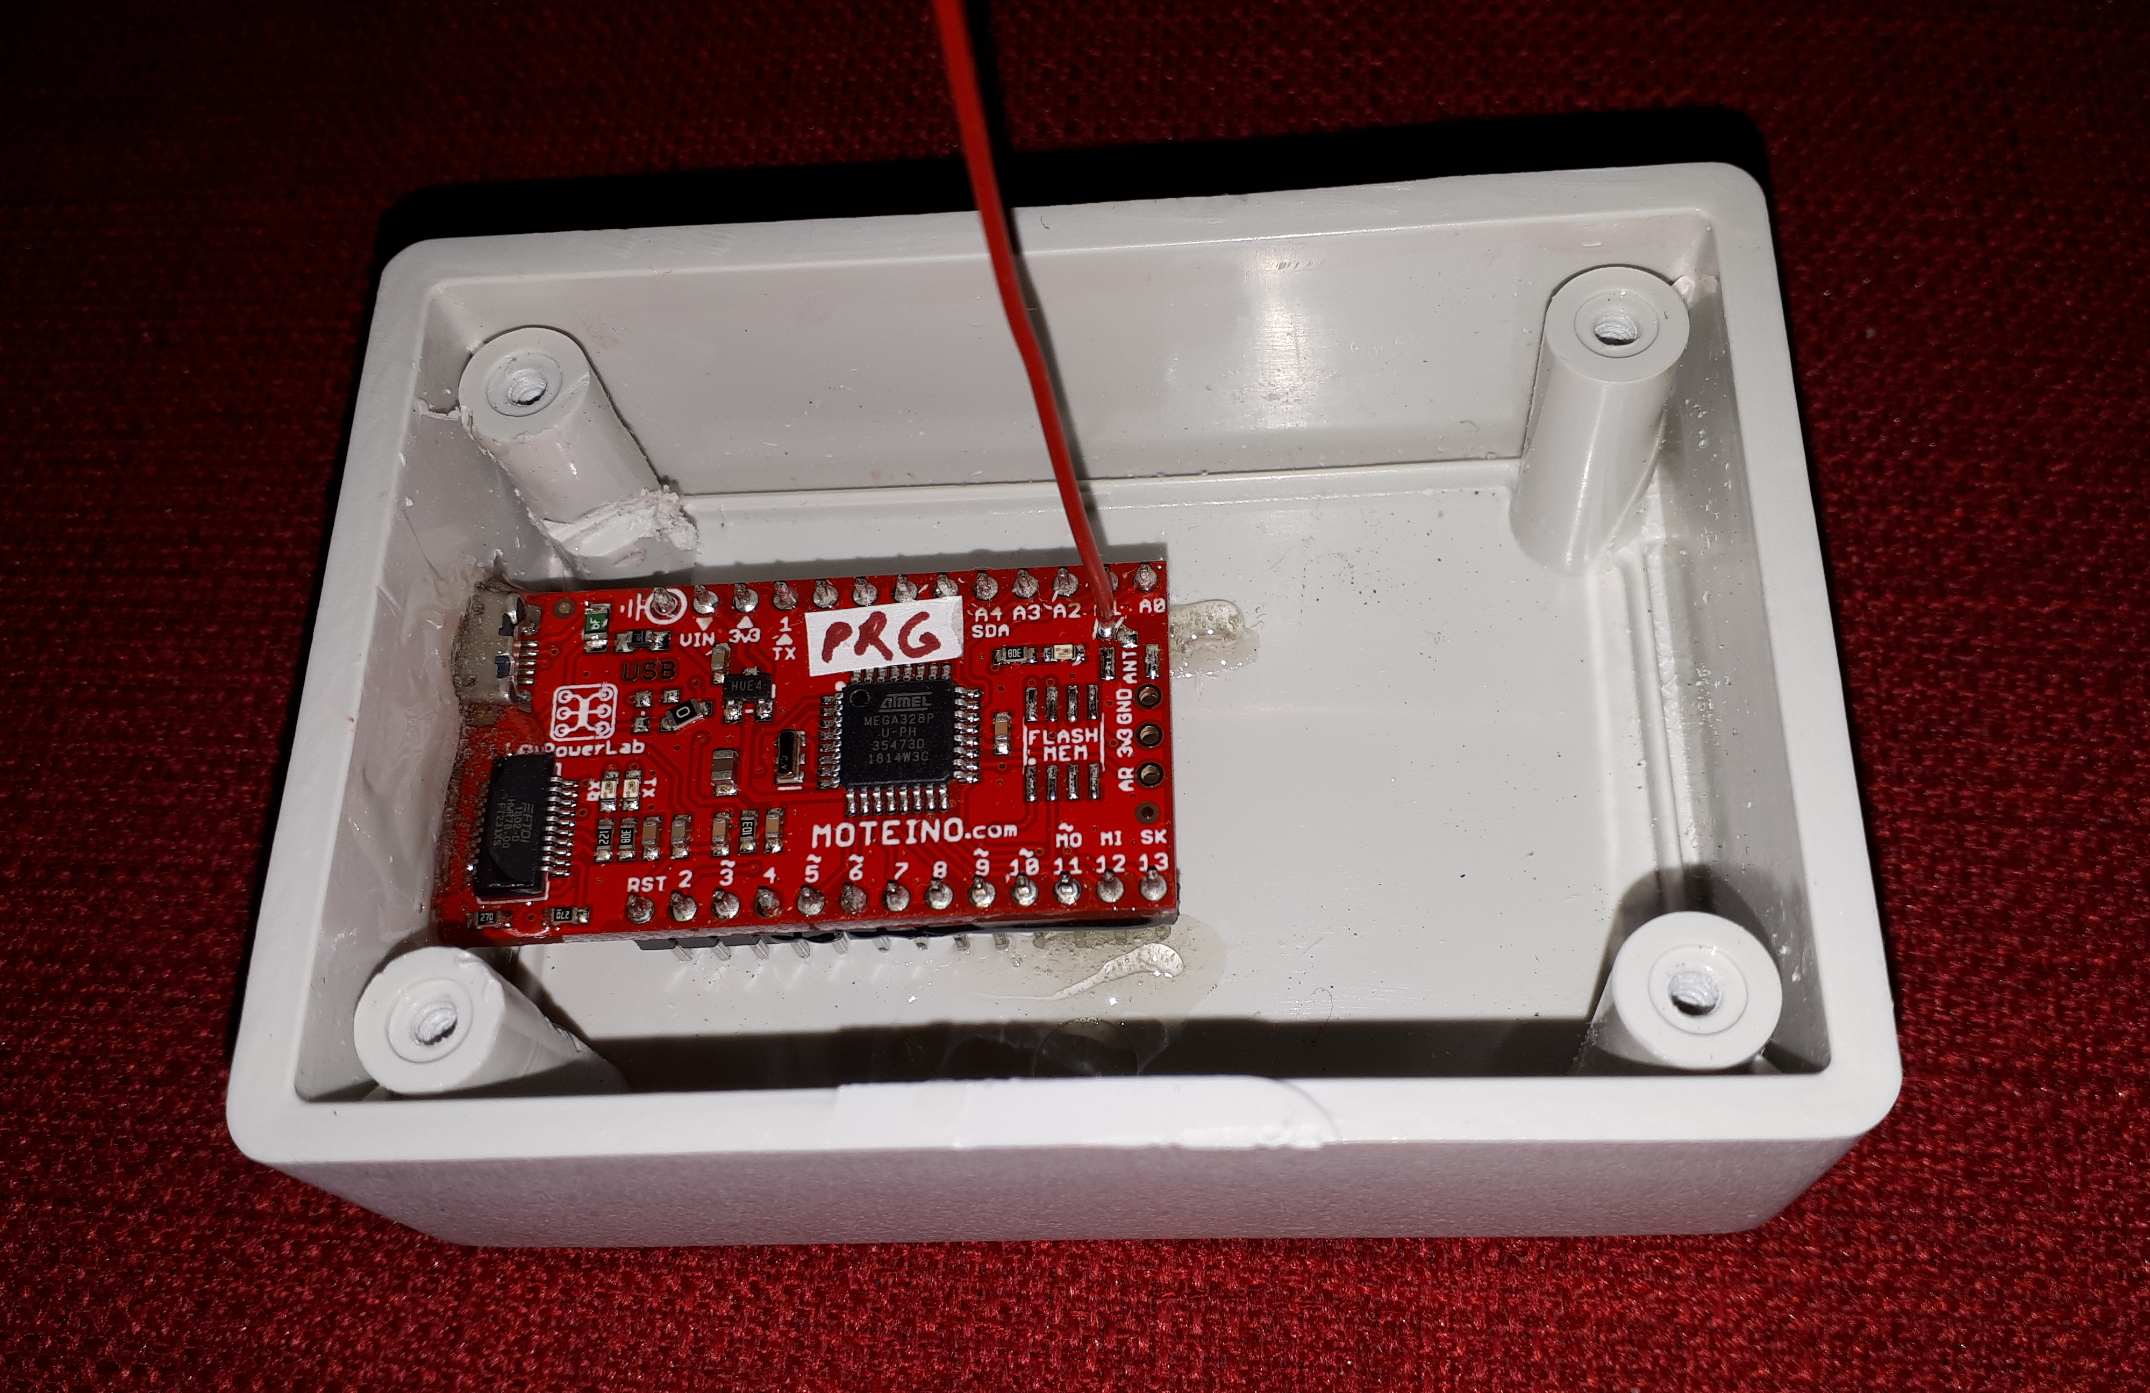
Optional: connect an LED to D9 and mount to case.

Slide 22
RGB LED Pixel String Variations

Slide 23
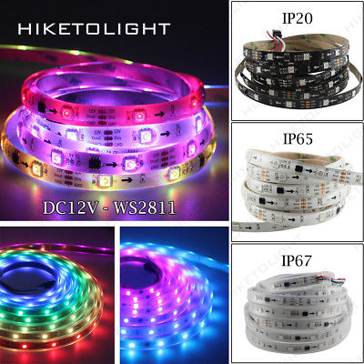

Slide 24
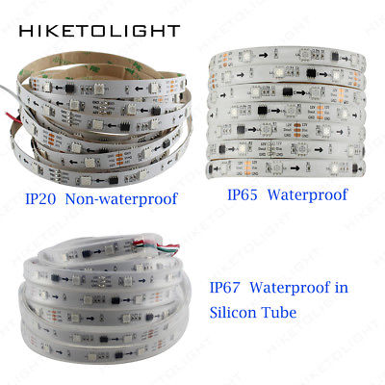
Silicon coating.

Slide 25


